Slide 1
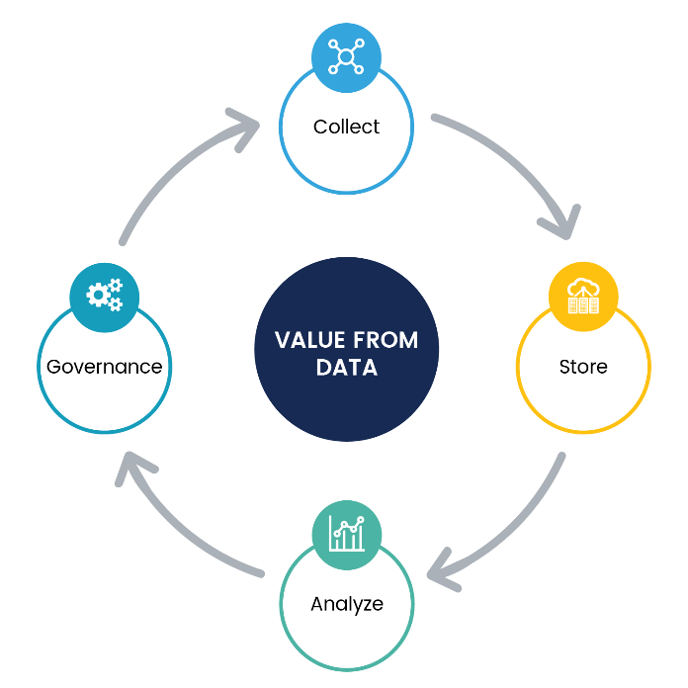
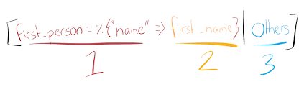
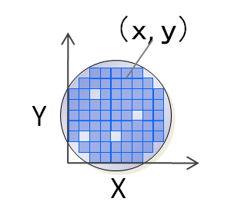
Pattern Matching From Silicon to Software
soundararajan

Slide 2


Agenda
Introduction 4
About you all
About me
Philosophy of Pattern matching 5
Silicon 15
Pattern matching in Silicon wafer inspection
Software 15
Pattern matching in Healthcare Information Technologies
Pattern Matching in Practice 60
Algolia structural pattern matching
Stanford NLP library for Grammatical Inference
Google Cloud
Q & A 15
Buffer / Break 11

Slide 3


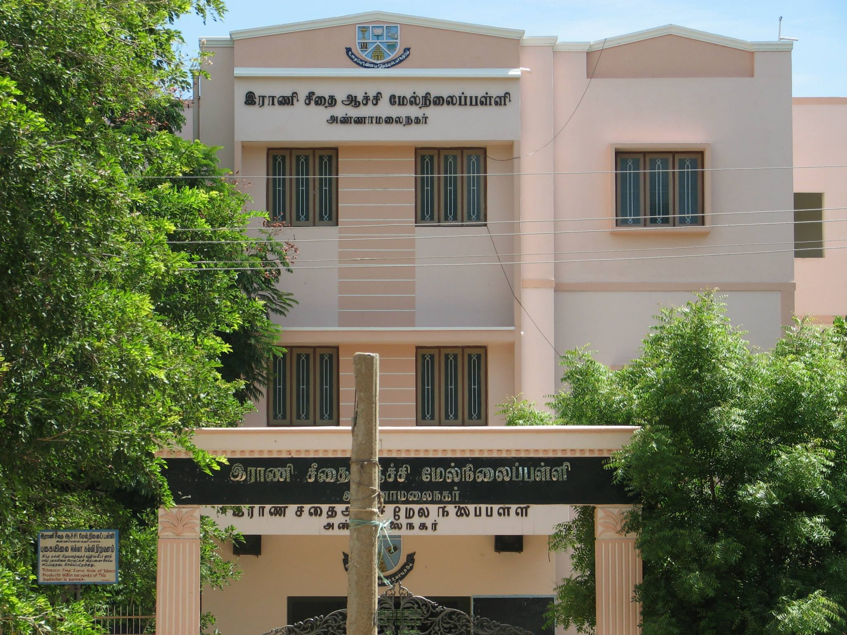
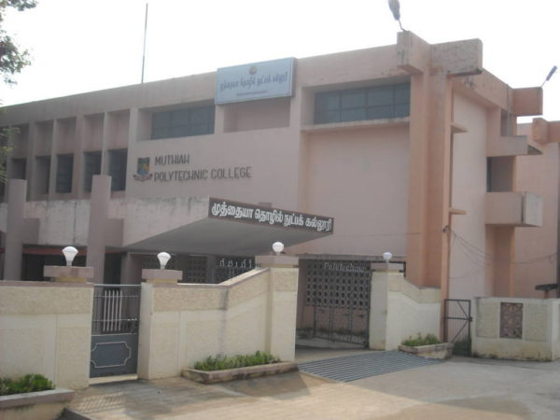
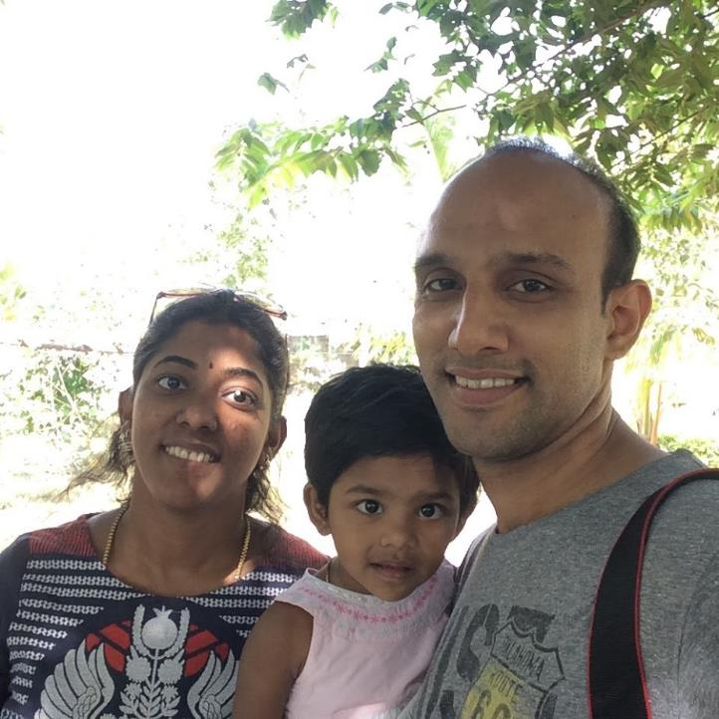
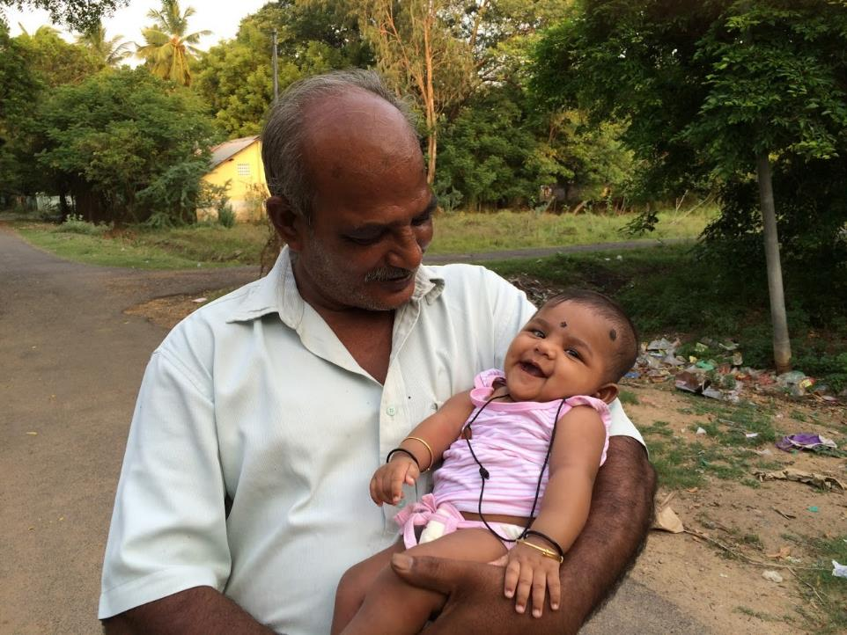
About me

Slide 4
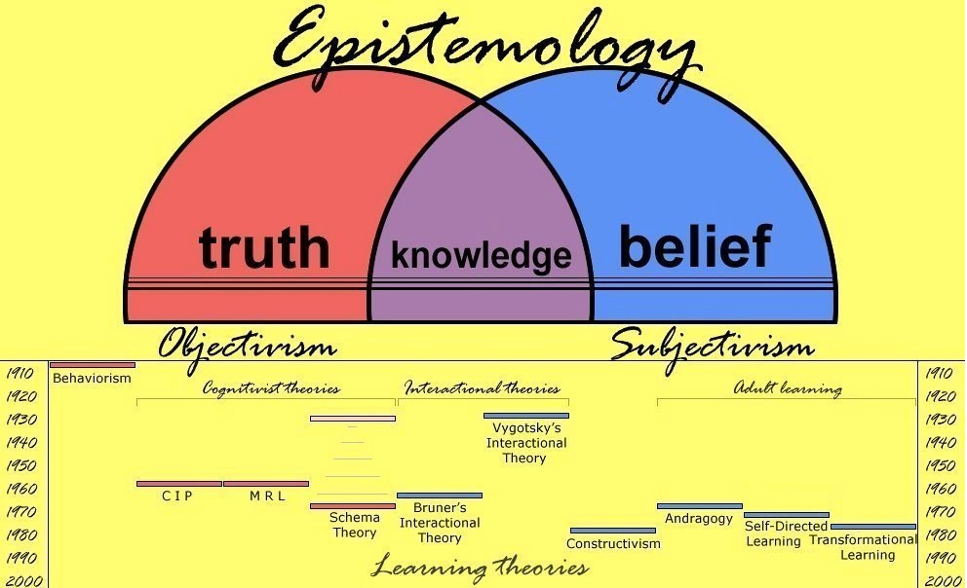
Philosophy of Pattern Matching

Slide 5



Silicon Wafer Inspection
Click above to start the video

Slide 6
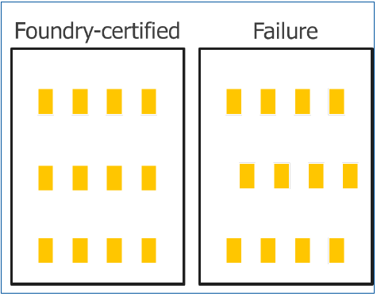
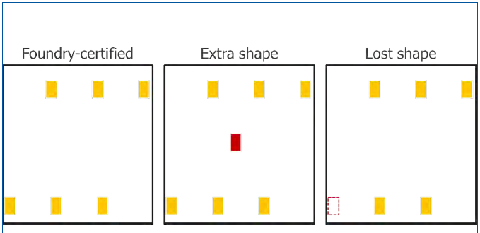
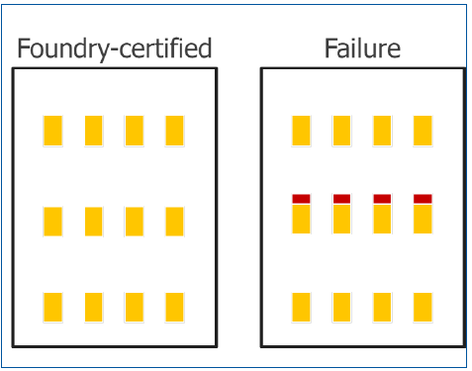
The problem
Shape shifting
Extra / Fewer Shapes
Shapes change

Slide 7
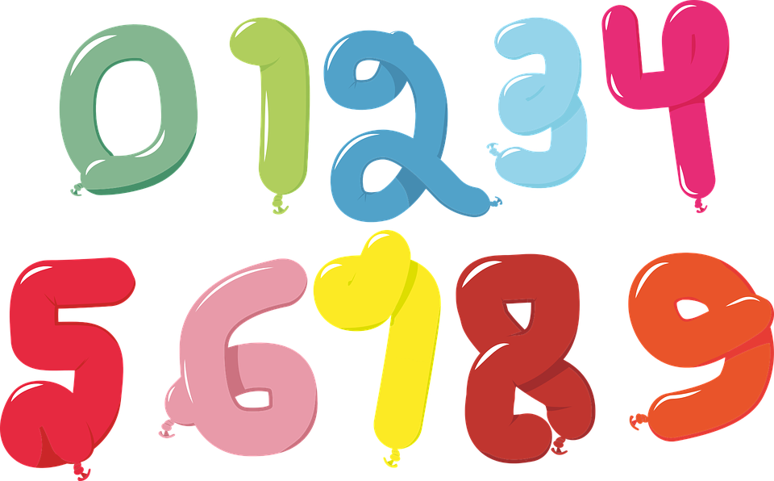
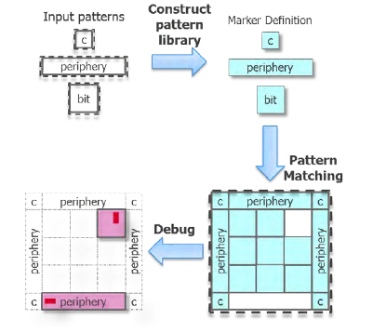
The Solution

Slide 8

The role of pattern matching

Slide 9
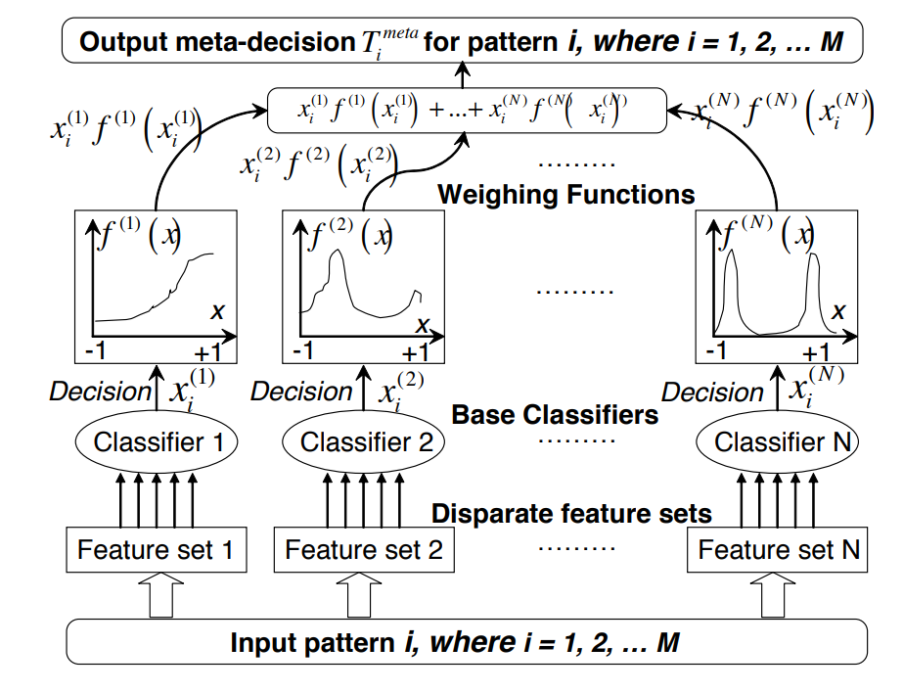
Some details …

Slide 10
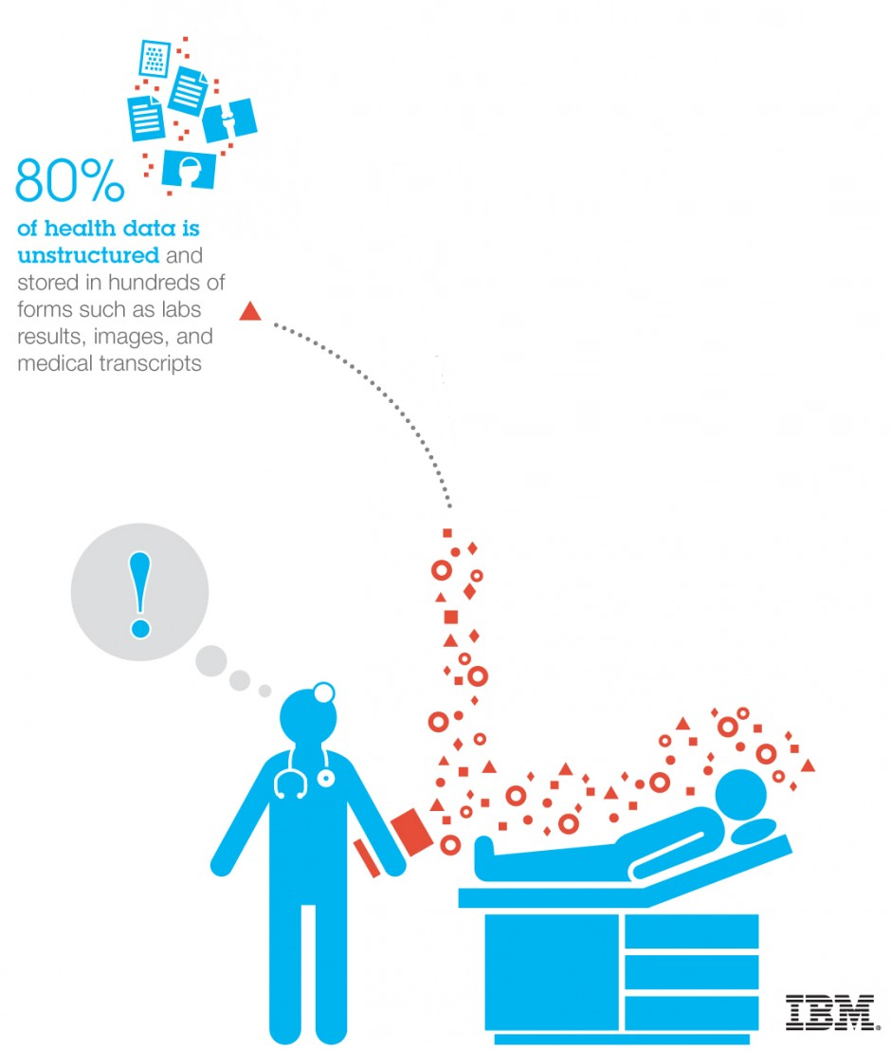


Pattern Matching in Healthcare
The Problem
The Solution

Slide 11

A note on SQL and noSQL
SQL Server provider table (but not necessarily bad)
Not usable for BigData operations because of referential constraints and schema oriented CURD operations.
Mongo DB provider table (but not necessarily the greatest)
No discipline on CURD operations
Key, Value pair.
Flexible for unorthodox operations.

Slide 12
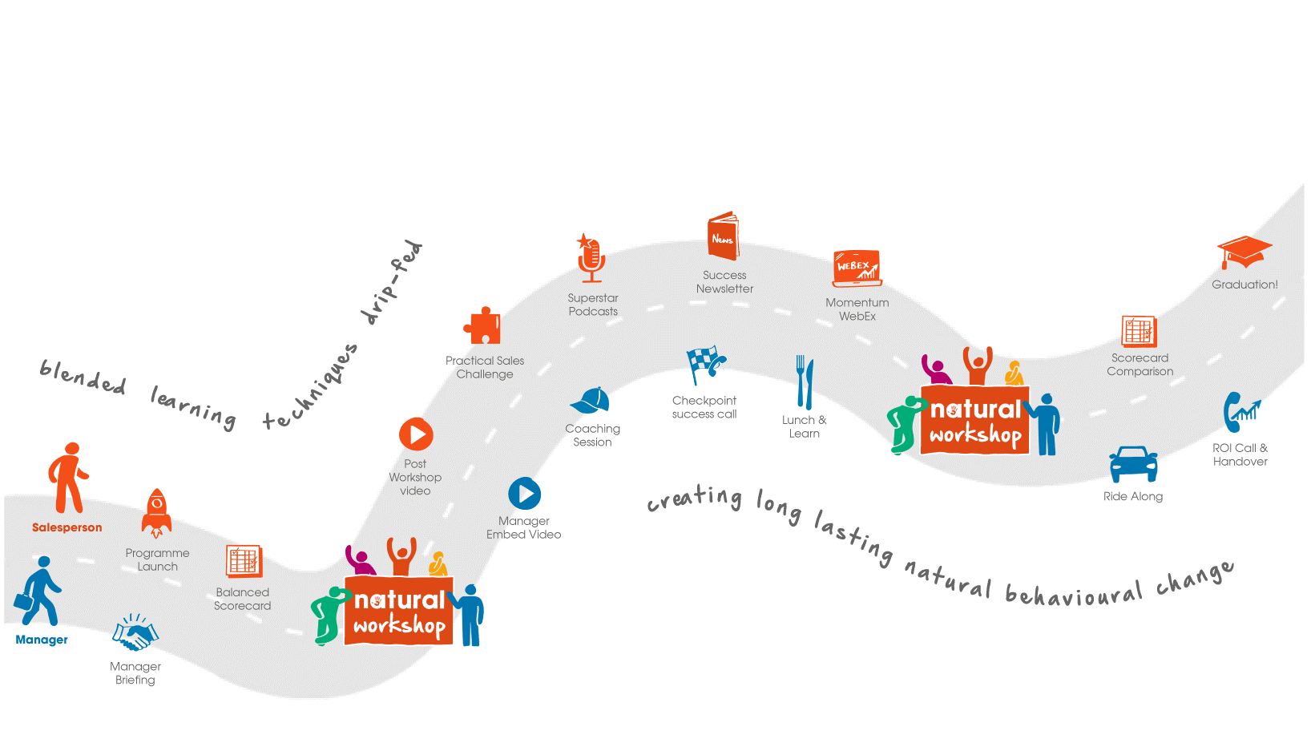
Different Approaches
Idealistic
Expert systems
Belief networks
Probabilistic networks
Spiritualistic
Syntactic pattern recognition
Structural pattern recognition
AI
Materialistic
Neural Networks Vision
Realistic
Grammatical Inference
Machine Learning
Grammatical Inference
Structural Pattern Recognition

Slide 13
Structural Pattern Recognition
Text matching for providers
Search for AUDREY WAROLIN in conventional database (link)
Search the same with Algolia (link)
Typo tolerance
Synonyms
Query Rules

Slide 14
BigData, NoSQL , MongoDB
Find the provider information by state
Discuss the problems with the data, why pattern matching is required
Find the number of Male and Female providers in US (Clustering)
Issues with data
Conditions on Entity Types
Results

Slide 15
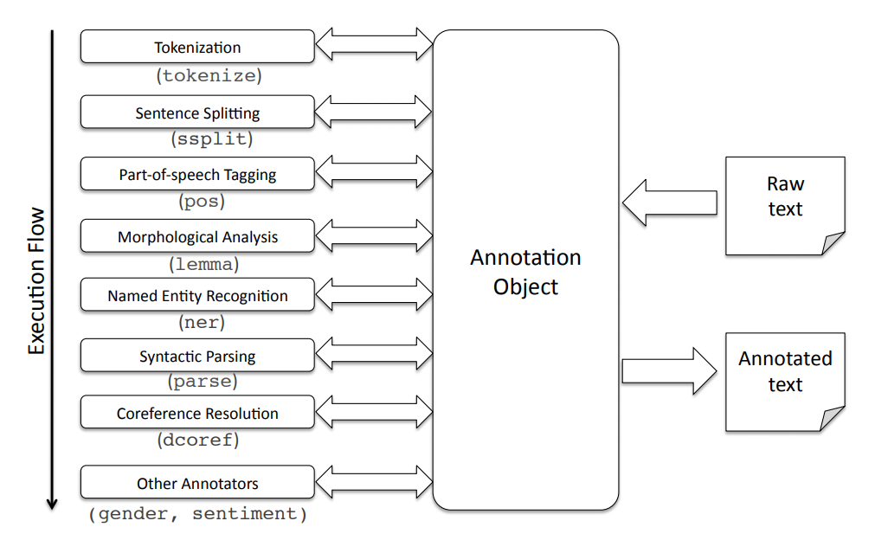
Stanford CoreNLP

Slide 16
Stanford CoreNLP demos
Named Entity Recognition (ner)
Names
US States
Date
Parts of Speech Tagger (pos)
Subject
Connections
Sentiment Analysis (sent)

Slide 17



Questions
http://soundararajan.in
soundararajan@outlook.com
twitter.com/soundararajan

